Slide 1
Writing an Effective
Fall 2013 Workshop #4

Slide 2
Today’s Objectives
Review Category 1: Student Success and Achievement
Category 2: Faculty Development and Curriculum
Category 3: Institutional Support

Slide 3
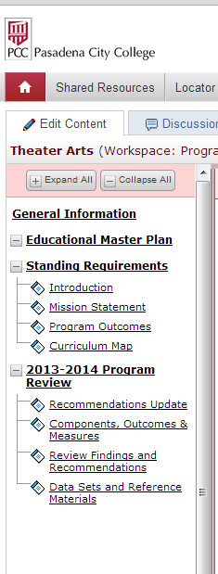
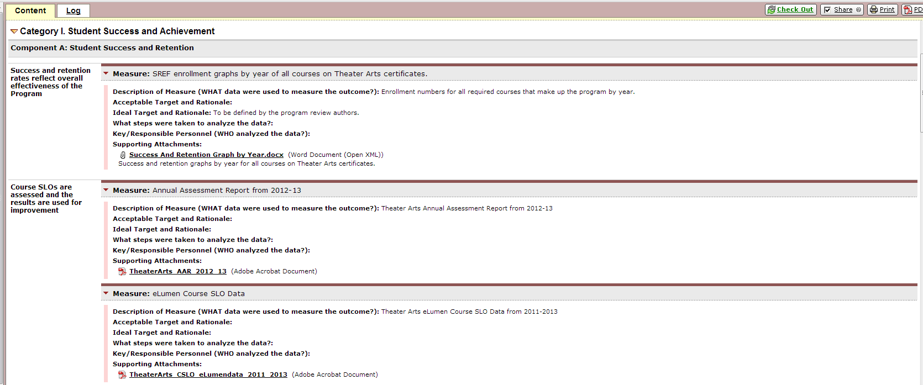
Taskstream

Slide 4
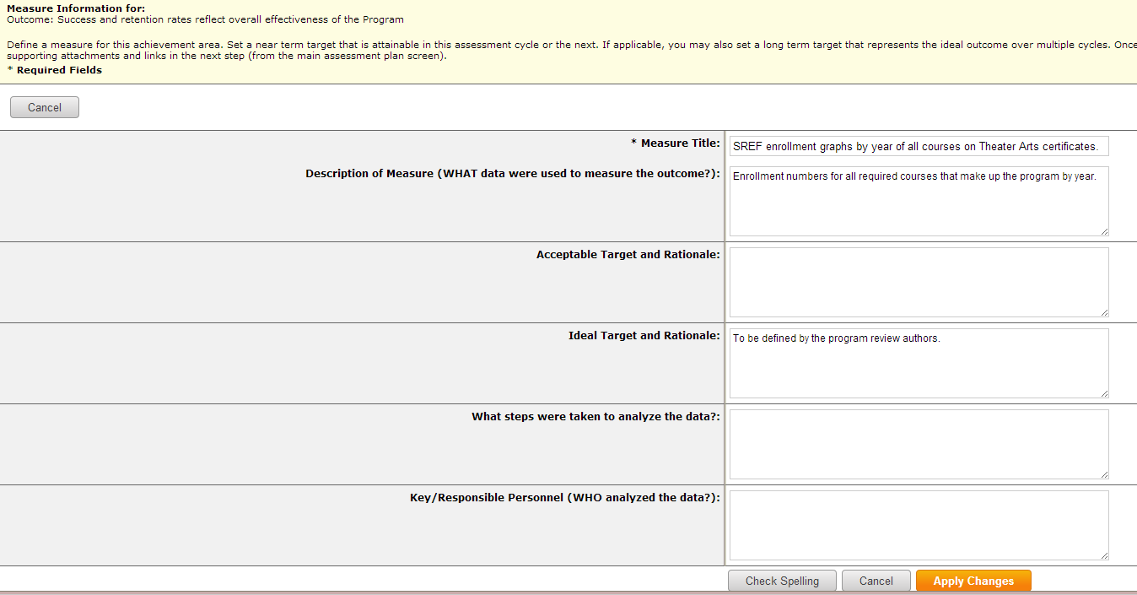

Slide 5
Evaluation Categories
Student Success and Achievement
Institutional Support
Faculty Development and Curriculum

Slide 6
Category I. Student Success and Achievement CTE, GE, Academic, All areas
Component A: Student Success and Retention | Success and retention rates reflect overall effectiveness of the Program Provide Targets: Success=71%, Retention (persistence)=52.92% Course SLOs are assessed and the results are used for improvement | Success and Retention for required courses by year as a Graph in SREF Spreadsheet eLumen Data by course
 | Program SLOs are assessed and the results are used for improvement GEOs are assessed and the results are used for improvement | eLumen Data for Program SLOs by program eLumen Data for GEOs by department
Component B: Demographics | Success rates by demographic groups are evaluated | All success rates by demographic groups by year as a Graph from Success by Demographics Spreadsheet
 | Diversity demographics and recruitment efforts are evaluated | All demographic information by year as a Graph from Demographics Spreadsheet
Component C: Progression and Awards Conferred | Program demonstrates consistent enrollment based on demand Courses are offered in a sequence and frequency that facilitates program completion Number of awards granted demonstrates the effectiveness of the program | Enrollment by Year Graph from SREF Spreadsheet Course Scheduling Worksheet Completion numbers Graph by Year from IPRO Spreadsheet

Slide 7
Category II. Faculty Development & Curriculum
Component A: Faculty Development | Full-time and part-time faculty pursue necessary professional development and growth | PCC Professional Development Survey Professional Development Needs Worksheet
Component B: Curriculum | Success and retention data for distance education courses are compared to the face-to-face courses. Program curriculum is aligned with appropriate external agencies, regulations, and/or professional organizations Curricula are properly articulated with K-12 and/or CSU and UC systems | Success and retention data for distance education courses as compared to the face-to-face courses from IPRO Curriculum Alignment Worksheet Articulation Worksheet
 | All Course Outlines of Record are reviewed and, if necessary, updated once every two years for CTE (or six years for Academic & GE Programs) | Course Outline of Record Review Worksheet
CTE, GE, Academic, All areas

Slide 8
Category III. Institutional Support
Component A: Budget | Number of full-time and part-time faculty and staff meets program needs College resources are effectively allocated to meet program needs (equipment, technology, supplies, etc.) Full-time and part-time staff pursue necessary professional development and growth | % of Full-time to Part-time faculty (Sections doc from IPRO) Resources Needs Worksheet (may include comparison to similar programs) Professional Development Needs Worksheet
Component B: Space Allocation | The space needs of the program are met | Space Needs Worksheet
CTE, GE, Academic, All areas

Slide 9
To Do
1. Complete Your Program Review
a. Use Taskstream
OR
b. Use the Word doc
2. Program Reviews for Seminar participants due no later than January 30.
3. Need more help?
One on one appointment with Stephanie
X3214, slhood@Pasadena.edu
4. Taskstream ?’s:
Crystal Kollross

