Slide 1
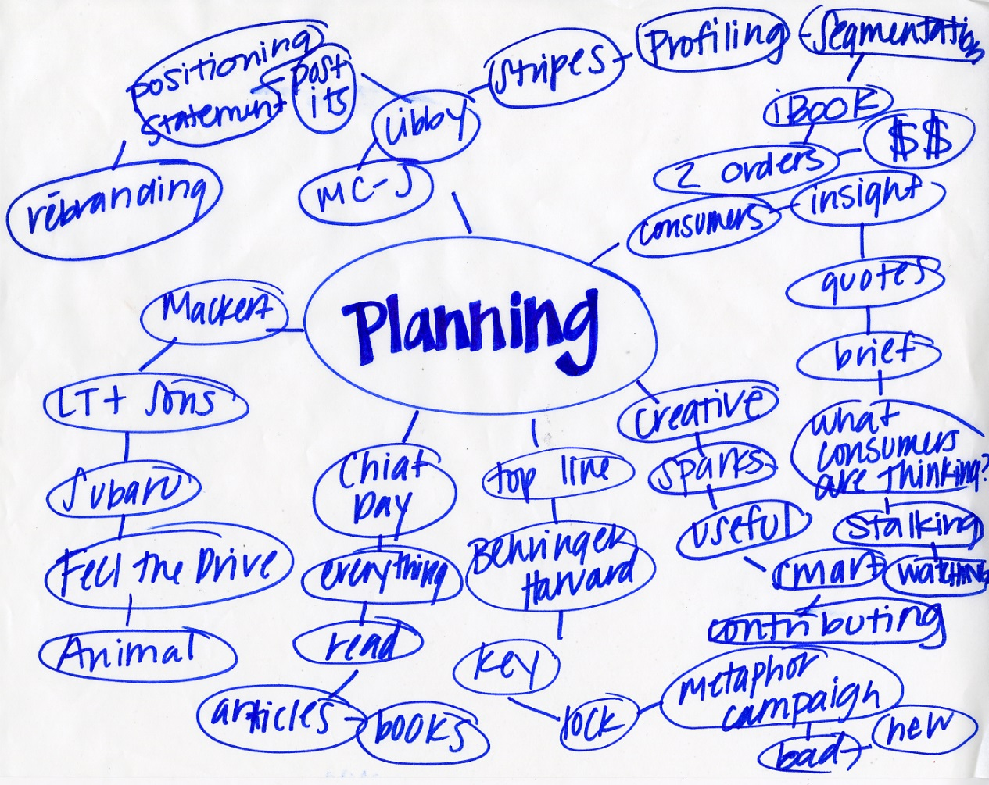
Integrated Planning

Slide 2
Student Achievement
& Student Learning
Evaluation
Improvement Goals
Resources
Resource
Allocation
Program Review
Planning

Slide 3
ACCJC says that . . .
program review and planning should inform/direct resource allocation

Slide 4
From Guide to Evaluating Institutions from ACCJC
Improvement is achieved through an ongoing and systematic cycle of evaluation, integrated planning, implementation, and re-evaluation.
The planning cycle begins with evaluation of student needs and college programs and services.
This evaluation in turn informs college decisions about where it needs to improve, and the college identifies improvement goals campus wide.
Resources are distributed in order to implement these goals.
Evaluation
Improvement Goals
Resources

Slide 5
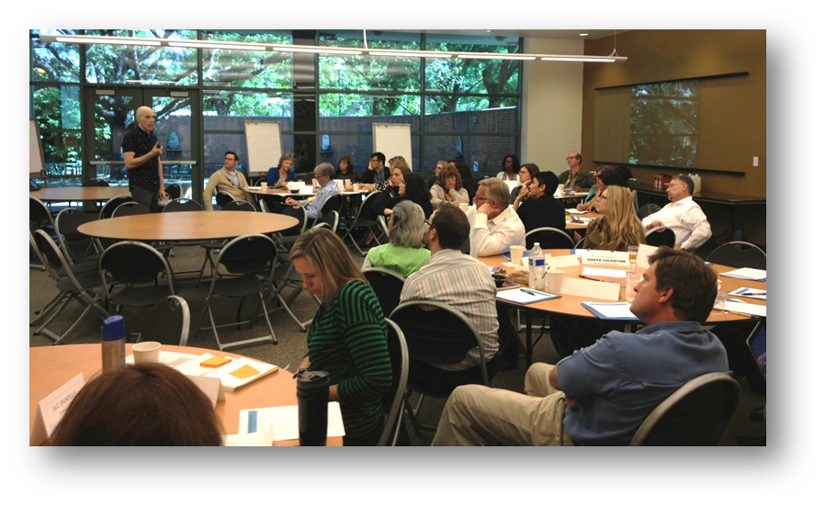
Integrated Planning Study Sessions
Spring 2013
Fall 2013
Discussed Basics of Integrated Planning
Examined Accreditation Requirements
Looked at Committee Roles
Identified Areas of Improvement
Evaluation of Existing Model
A Sample Model

Slide 6
Study Session #1 Recommendations:
We are unclear about the current processes; overall communication problem
Need more access to information
Sync the timelines of the processes for program review, planning, and resource allocation on an annual cycle

Slide 7
Study Session #1 How can we improve?
Articulate process for IEC recommendations to be considered for inclusion into the EMP
Make all constituents aware of our integrated planning model
Develop a consistent tracking system to ensure that IEC recommendations are enacted
Develop a rubric for resource allocation that aligns with the PCC Mission, EMP, Annual College Goals, and other criteria determined by BRAC
Clear roles and processes for committees (BRAC, IEC, P&P)
Align the timelines for program review, planning, and resource allocation with the budget cycle
Our existing model captures the needs that are common to multiple programs, but does not capture individual program needs: develop a means for individual programs to request resources informed by their program reviews and included in their plans
Increased participation and transparency at all levels of program review, planning, and resource allocation

Slide 8
Study Session #2 Recommendations:
Lack of communication/collaboration between committees
Timelines and overall process are unclear
We lack an efficient, transparent, easily understandable process

Slide 9
Study Session #2 How can we improve?
Create a system/webpage for tracking IEC Broad Recommendations and Program Review Summaries
Make information available by Having cross membership on IEC, P&P, and BRAC and A periodic meeting of the Co-Chairs of the three committees
Clear timeline
Increase awareness
Clear visual that explains the process
Go beyond compliance
Publish program review recommendations

Slide 10
Study Session #2 How can we improve?
Rubric for resource allocation with clear criteria
BRAC makes resource allocation decisions with input from IEC and P&P
Increase Transparency
Increase communication with BRAC, IEC, P+P
Increase Efficiency
Clear Process
Set clear priorities and needs

Slide 11
A sample model . . .

Slide 12
Key factors
PCC budget process begins Feb 1
These bodies should be included:
IEC (Program Review)
BRAC (Resource Allocation)
P&P (Institutional Planning/EMP)
College Council (Input to the President)
Senior leadership (President and Senior VPs)
Board of Trustees (Final Decisions)

Slide 13
June 30
Sept 1
Oct 1
Nov 1
IEC Broad Recommendations
Program Reviews finalized & feedback to authors
Area Plans
Board Goals
School Plans Draft 1
Unit Plans
School Plans Final Draft
Department Plans
Nov 30
Jan 30
BRAC: resource requests (incl. non-faculty hires)
Senior Leadership
Feb 1
Prioritization
Departments identify needs in plans
School Deans work with a committee to prioritize needs for entire School
College Council
P&P: EMP Update
CAPM: Faculty hires

Slide 14
Evaluation of Sample Model
Process may be too lengthy for all requests and there needs to be a faster “emergency” model for resource allocations that need to happen before the next year
Timeline needs to be contextualized by other dates & Academic Calendar
Should College Council should be before senior leadership? Or should C.C. be the last group to facilitate communication?
May need back and forth communication between Senior Leadership and BRAC
Consider representation of all constituent groups throughout the process

Slide 15
Next steps?

Slide 16
Next Steps…
Develop resource allocation rubric
Distinguish on-going resource allocation requests from one-time funding requests
Get feedback from IEC, P&P and BRAC - document the conversation in a public space
Committees need to start having conversations about their roles in the larger process
Create a focus group and solicit members of each committee to participate in the team creating the process
Standing reports should be made to Ac. Sen. /Class. Sen/AS

Slide 17
Next Steps…
BRAC’s role and representation needs to be clarified
BRAC should create funding categories
Loop needs to be closed-report back to IEC on funding decisions
Broad recs from IEC should be disseminated to all other bodies
Clarify how all constituents in different areas/programs/departments fit in

